Slide 1
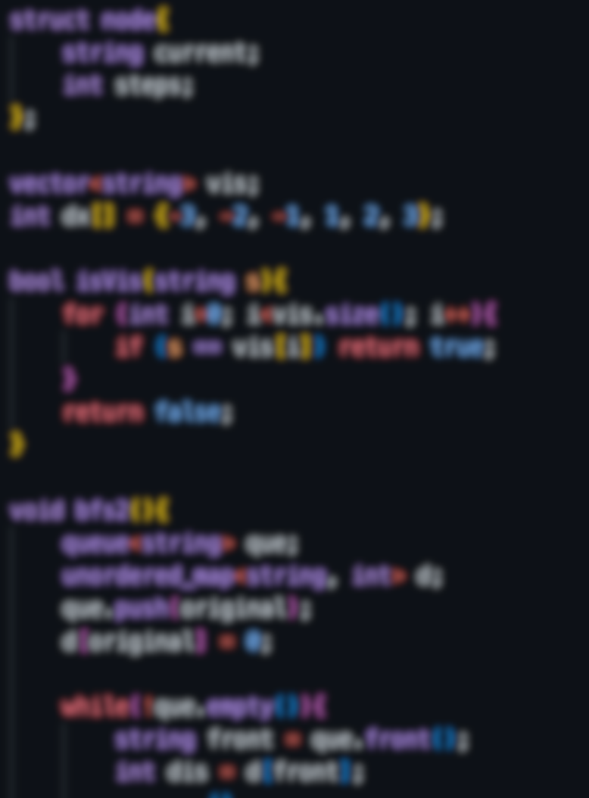
First Edition
Introduction of Algorithms
For Beginners
©Marco’s Original Edition

Slide 2
This is an internal book and should not be reproduced without permission.
©Marco’s Original Edition

